Slide 1

MATH30
Probability and Statistics

Slide 2
Observation
Observation Any recording or information, whether it be numerical or categorical.
Examples:
The numbers 2, 0, 1, and 2, representing the number accidents that occurred for each month from January through April during the past year at the intersection of Ayala Avenue and EDSA, constitute a set of observations (numerical).
The categorical data N, D, N, N, and D, representing the items found to be defective or nondefective when five items are inspected, are recorded as observations.

Slide 3
Experiment
Statisticians use the word experiment to describe any process that generates a set of data.
Examples:
Tossing of a coin which has only two possible outcomes, heads or tails
Launching of a missile and observing its velocity at specified times

Slide 4
Sample Space and Sample Point
The set of all possible outcomes of a statistical experiment is called the sample space and is represented by the symbol S.
Each outcome in a sample space is called an element or a member of the sample space, or simply a sample point.
Example:
The sample space S, of possible outcomes when a coin is tossed, may be written
S = {H, T},
where H and T correspond to “heads” and “tails”, respectively.

Slide 5
Sample Space and Sample Point
Example 2.1:
Consider the experiment of tossing a die. If we are interested in the number that shows on the top face, the sample space would be
S₁ = {1, 2, 3, 4, 5, 6},
If we are interested only in whether the number is even or odd, the sample space is simply
S₂ = {even , odd}

Slide 6
Tree Diagram
In some experiments it is helpful to list the elements of the sample space systematically by means of a tree diagram.
Example 2.2: An experiment consists of flipping a coin and then flipping it a second time if a head occurs. If a tail occurs on the first flip, then a die is tossed one. To list the elements of the sample space providing the most information, we construct the tree diagram of Figure 2.1.

Slide 7
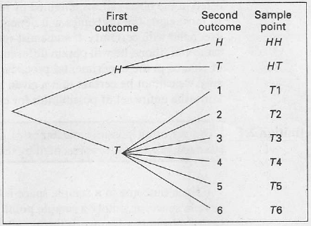
Tree Diagram
Figure 2.1 Tree diagram for Example 2.2.
S = {HH, HT, T1, T2, T3, T4, T5, T6}

Slide 8
Tree Diagram
Example 2.3: Suppose that three items are selected at random from a manufacturing process. Each item is inspected and classified defective, D, or nondefective, N. To list the elements of the sample space providing the most information, we construct the tree diagram of Figure 2.2. If we have the sample point DDD, it indicates the possibility that all three items inspected are defective.
S = {DDD, DDN, DND, DNN, NDD, NDN, NND, NNN}

Slide 9
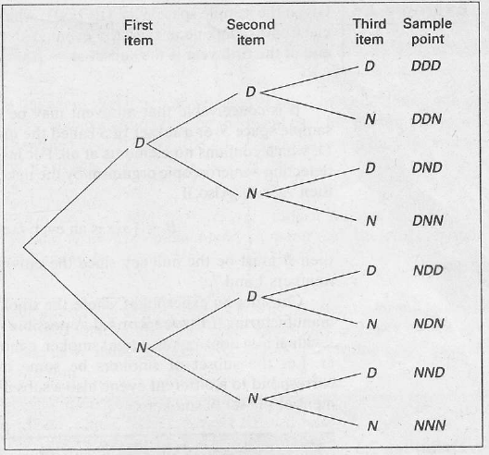
Tree Diagram
Figure 2.2 Tree diagram for Example 2.3.

Slide 10
Event
An event is a subset of a sample space.
Example 2.4: Given the sample space S = {t|t ≥ 0}, where t is the life in years of a certain electronic component, then the event A that the component fails before the end of the fifth year is the subset A = {t|0 ≤ t < 5}.
If we let A be the event of detecting a microscopic organism by the naked eye in a biological experiment, then A = Ø.
Let B = {x|x is an even factor of 7}, then B = Ø or B = {}.

Slide 11
Complement of an Event
The complement of an event A with respect to S is the subset of all elements of S that are not in A. We denote the complement of A by the symbol A′.
Example 2.5: Let R be the event that a red card is selected from an ordinary deck of 52 playing cards, and let S be the entire deck. Then R′ is the event that the card selected from the deck is not a red but a black card.

Slide 12
Complement of an Event
Example 2.6: Consider the sample space
S = {book, catalyst, cigarette, precipitate, engineer, rivet}.
Let A = {catalyst, rivet, book, cigarette}. Then
A′ = {precipitate, engineer}.

Slide 13
Intersection of Events
The intersection of two events A and B, denoted by the symbol A ∩ B, is the event containing all elements that are common to A and B.
Example 2.7: Let P be the event that a person selected at random while dining at a popular cafeteria is a taxpayer, and let Q be the event that the person is over 65 years of age. Then the event P ∩ Q is the set of all taxpayers in the cafeteria who are over 65 years of age.

Slide 14
Mutually Exclusive Events
Two events A and B are mutually exclusive, or disjoint if A ∩ B = Ø, that is, A and B have no elements in common.
Example 2.8: Let M = {a, e, i, o, u} and N = {r, s, t}; then it follows that M ∩ N = Ø. That is, M and N have no elements in common and, therefore, cannot occur simultaneously.

Slide 15
Union of Events
The union of two events A and B, denoted by the symbol A U B, is the event containing all the elements that belong to A or B or both.
Example 2.9: In the die-tossing experiment, if
A = {2, 4, 6} and B = {4, 5, 6},
then A U B = {2, 4, 5, 6}.
Example 2.10: Let A = {a, b, c} and B = {b, c, d, e}; then
A U B = {a, b, c, d, e}.

Slide 16
Venn Diagram
Example 2.11: Samples of polycarbonate plastic are analyzed for scratch and shock resistance. The results from 50 samples are summarized as follows:
Let A denote the event that a sample has high shock resistance, and let B denote the event that a sample has a high scratch resistance. Determine the number of samples of A ∩ B, A′, and A U B.
 |  | shock resistance
 |  | high | low
scratch resistance | high | 40 | 4
 | low | 1 | 5

Slide 17
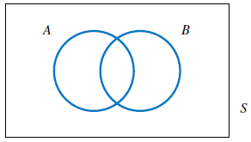
Venn Diagram
The event A ∩ B consists of the 40 samples for which scratch and shock resistances are high. The event A′ consists of the 9 samples in which the shock resistance is low. The event A U B consists of the 45 samples in which the shock resistance, scratch resistance, or both are high.

